Slide 1
British Airways Sentiment Analysis on Customers Feedback
Presented by: idris adebisi
23/12/2022

Slide 2
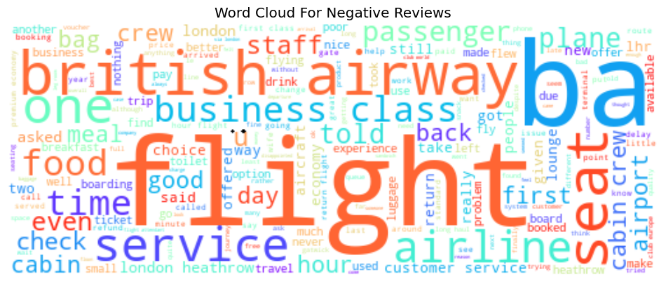
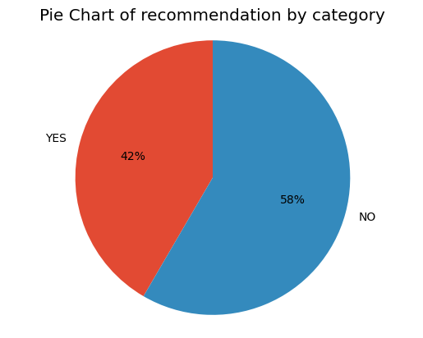
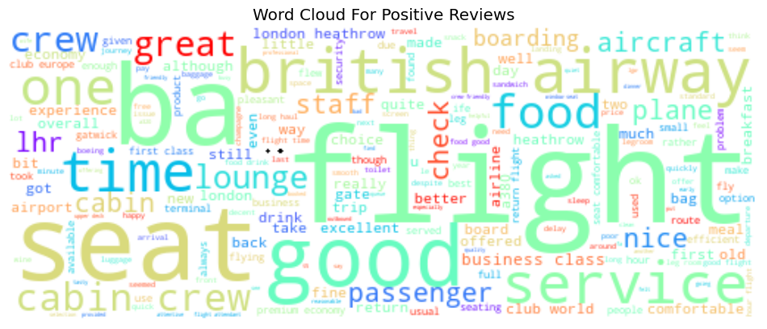
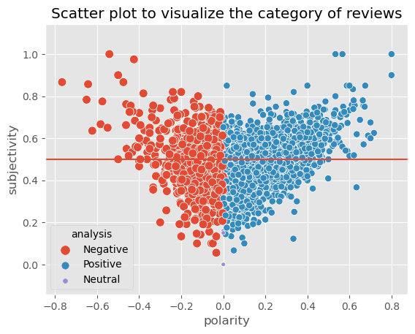
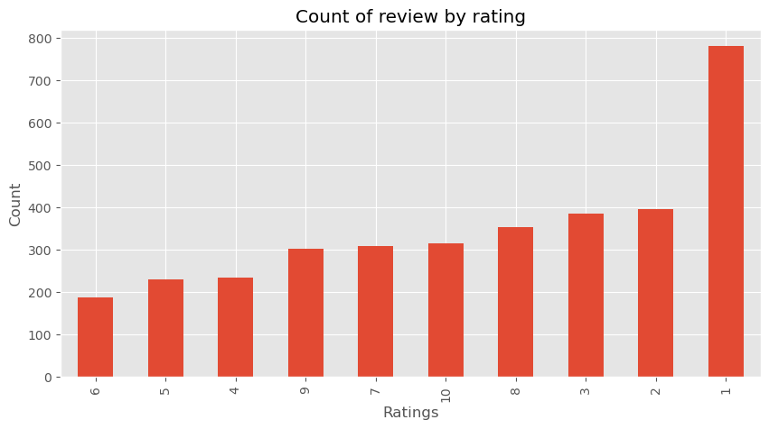
Graphical representation of findings
Findings from the Analysis
58% of customers wouldn't recommend the flight, while 42% were glad to do so.
The average customer rating is 10, and 22% of consumers gave a rating of one star.
The United Kingdom (UK), which has a higher proportion of customers, has an average rating of 4 stars, followed by the United States (US), where the average rating is 3.
Flight, seat, crew, service, and time are the five most frequent words from reviews of consumers who gave a positive recommendation.
Flight, seat, service, airline, and hour are the five most frequently occurring words in evaluations from clients who offered a poor rating.
This suggests that the majority of customers may view the same service differently.

